Slide 1
Predicting the popular area in NY city for opening restaurant

Slide 2
Predicting the popular area in NY.
To open a restaurant the main thing is to choose the place where to open
The chosen place should be popular with more number of visitors
Moreover the restaurant should have unique dishes than other restaurant
Hence need to find the above scenarios

Slide 3
Data acquisition and cleaning
The dataset newyork_data is already given by courseera
Dataset is in json format
In the dataset we considered many towns of NY city , each with its features is provided in the dataset
Each features have 13 different values
From 13 values 4 are considered they are borough,neighbourhood,latitude,longitude

Slide 4
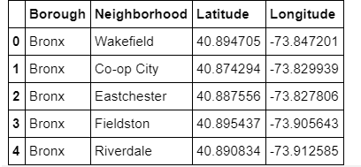
Data after cleaning:

Slide 5
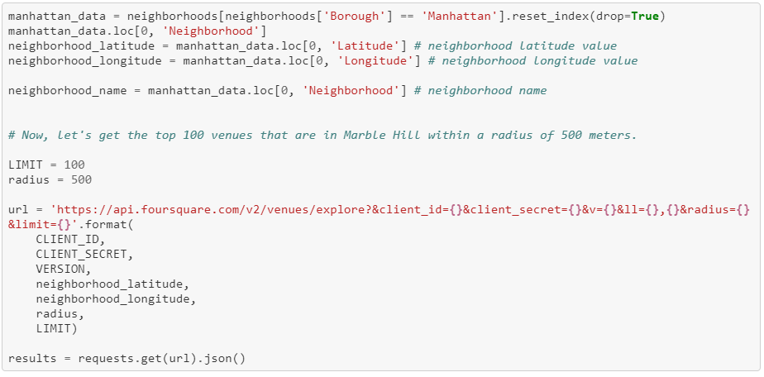
Step by step measures:
The top most 100 venues are retrieved by following code.

Slide 6
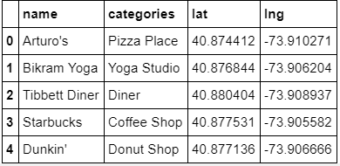
After this the function is written to extract the categories of venues
Then result is turned into dataframes
This results in nearby venues as below table

Slide 7
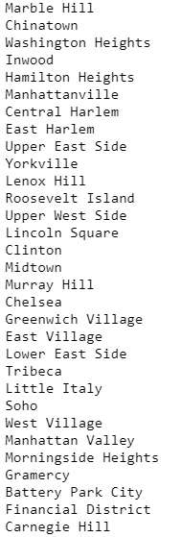
Exploring the neighbors of Manhattan because Manhattan is found as most popular town
This results in following venues

Slide 8
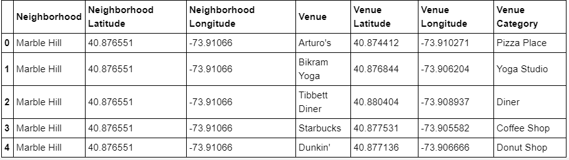
This retrieves around 3331 rows and 7 columns as below

Slide 9
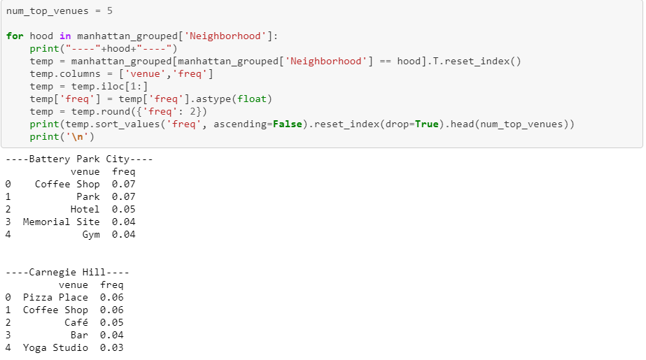
Analysis is done by using hot encoding
After the analysis top 5 common venues are retrieved

Slide 10
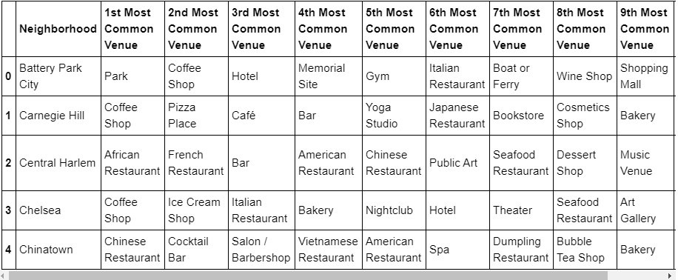
Then venues are sorted according to the popularity results the below table

Slide 11
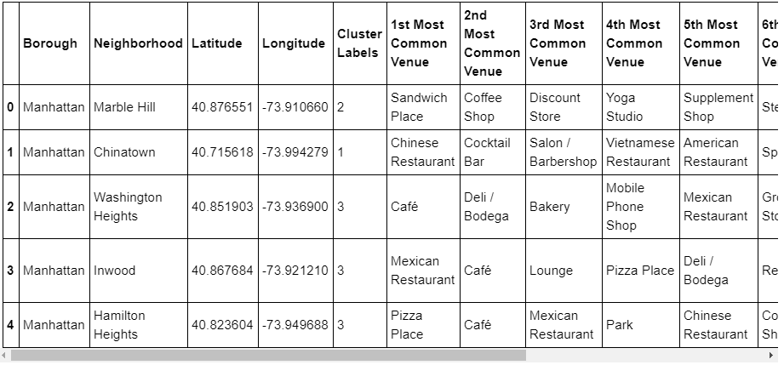
After above step clustering is done by giving the cluster labels the cluster of 5 is made results as below

Slide 12
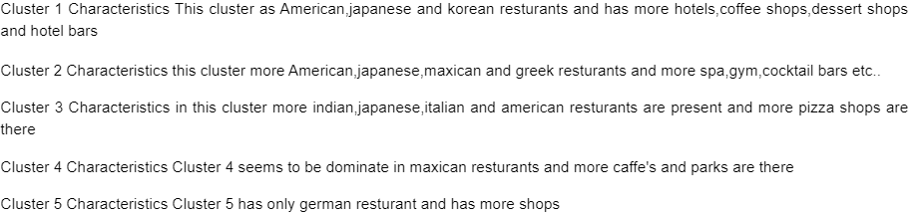
Then it is visualized in map
The result is shown below

Slide 13
Conclusion:
It will be a good idea to setup an Chinese , African , Canadian restaurants here because these neighborhoods are known for restaurants and have no above mentioned Restaurants that could stand as competitors. However, it could be helpful to check the demographics of people in these

